Slide 1
Implementation of SpMV Algorithm on HPC
Alex Chambers

Slide 2
Introduction
What is this method?
Why this method?
Why use High Performance Computing?

Slide 3
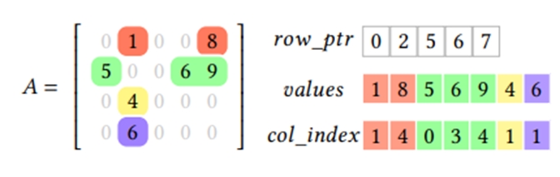
The Method
This method utilizes CSR
Types of SpMV algorithms

Slide 4
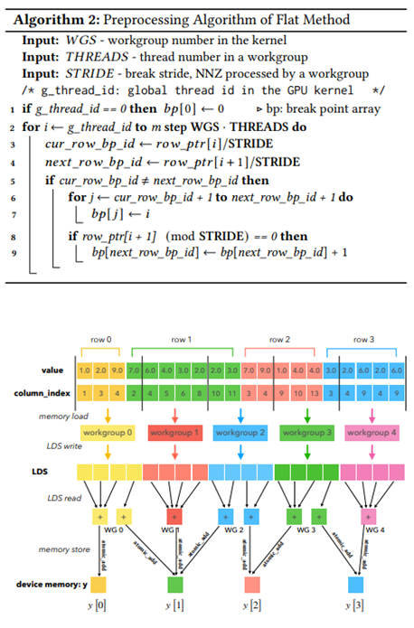
The Method
This method can be broken into five major steps:
Preprocessing
Initialization
Data Loading and Multiplication
Summation
Storage

Slide 5
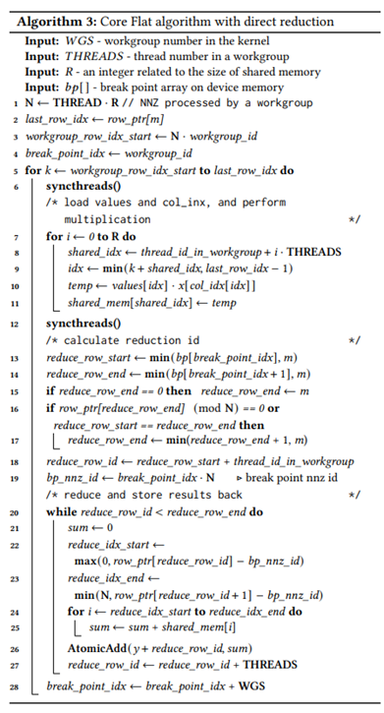
The Method
This method can be broken into five major steps:
Preprocessing
Initialization
Data Loading and Multiplication
Summation
Storage

Slide 6
Implementation

Slide 7
Implementation
Utilizing both MPI and OpenMP
Treating each device with MPI as a workgroup/block
Utilizing two devices for overhead

Slide 8
Current Implementation

Slide 9
Current Implementation
Have successfully implement
Works with any number of devices and threads
Currently need to write matrix/vector into file

Slide 10
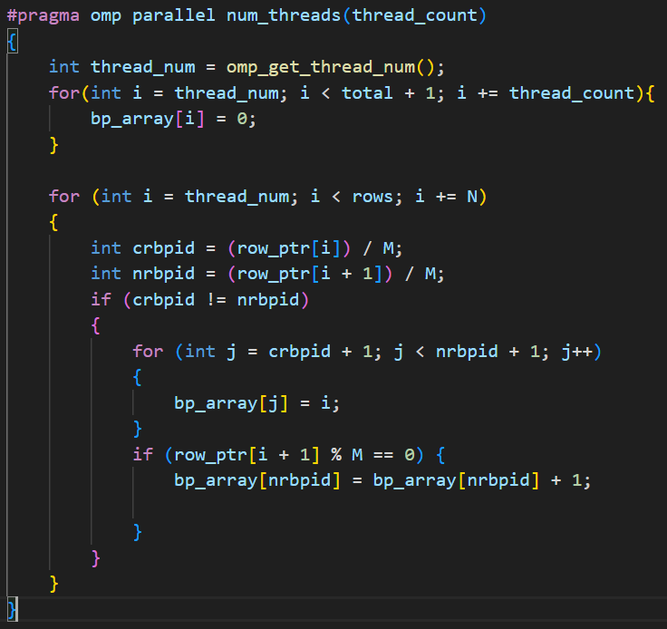
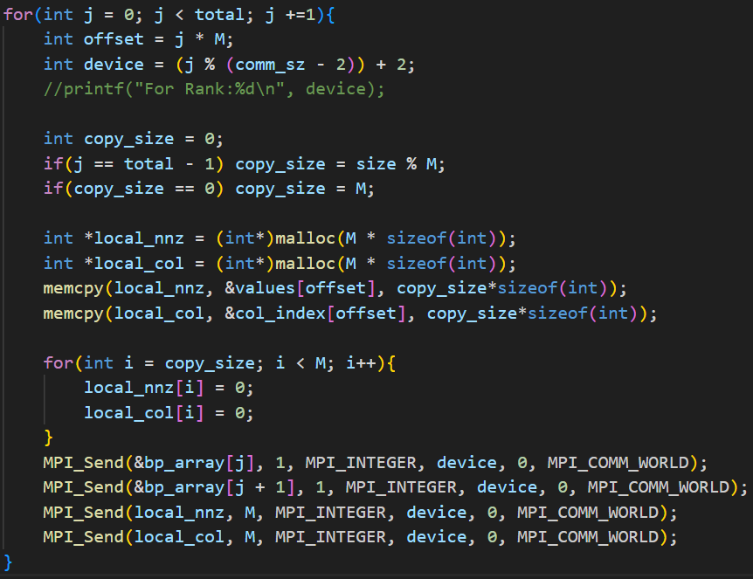
Current Implementation

Slide 11
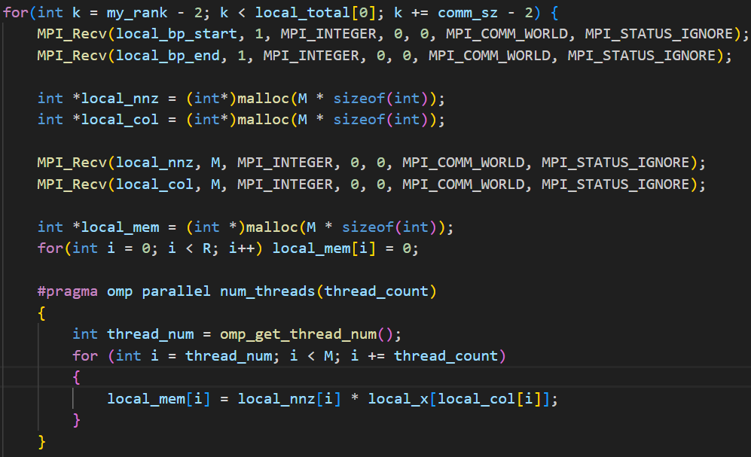
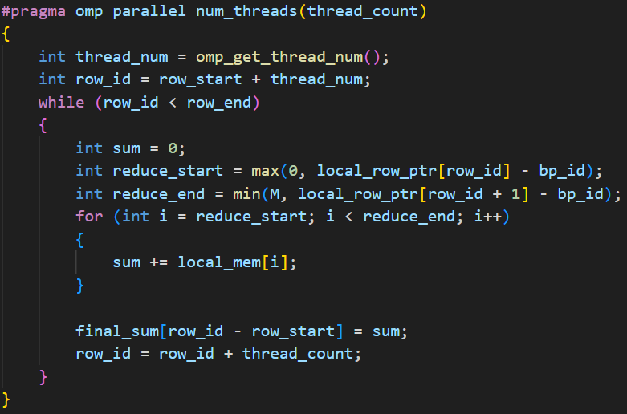
Current Implementation

Slide 12
Future Implementation
Read matrix/vector from file
Reduce overhead devices to one
Develop more rigorous testing method
Test using data sets from SuiteSparse Matrix Collection

Slide 13
Questions

